Slide 1
CMR College of Engineering & Technology
(UGC Autonomous)
Accredited by NAAC with “A” Grade
Kandlakoya, Medchal Road, Hyderabad-501401
Department of Computer Science & Engineering
Bitcoin price prediction using Machine Learning Algorithms
Guide Name:
Mr. B. SIVAIAH
Batch Number : 54
19H51A0572 : G. Keerthi
19H51A05D6 : K.V. Sri Divya
19H51A05D8 : L. Bhargavi
CMRCET - CSE
‹#›

Slide 2
Contents
Abstract
Introduction
Literature Survey
Existing works
problems in existed system
Research Objective of Presentation
Problem Definition
Research work
Proposed system architecture
Methods
Comparison of proposed system
Performance Measure
Results
Conclusion
Future Work
References
CMRCET - CSE
‹#›

Slide 3

Abstract
This project focuses on predicting the prices of Bitcoin, the most in-demand crypto- currency of today’s world.
The goal of this paper is to make sure with what accuracy the direction of Bitcoin price in USD can be predicted.
We start with Linear Regression models, and train on several important features, then We proceed with the implementation of Recurrent Neural Networks (RNN) with Long Short Term Memory (LSTM) cells.
We show that the price of Bitcoin can be predicted with Machine Learning with high degree of accuracy
CMRCET-CSE
‹#›

Slide 4
Introduction
The first decentralized digital currency or cryptocurrency, which was introduced in 2008 in a paper by author Satoshi Nakamoto, was Bitcoin .
Over the past few months, the cryptocurrency market has gone through enormous volatility.
There are various calculations utilized on financial exchange information for value forecasts. In this manner it is important to forecast the estimation of different cryptocurrencies so the right decision can be made.
The cost of these cryptocurrencies doesn't rely upon business occasions or mediating the government, not at all like securities exchanges.
CMRCET-CSE
‹#›

Slide 5
LITERATURE SURVEY

Slide 6
LITERATURE SURVEY
Supply and demand influence the prices of most commodities more than any other factor. Bitcoin's market value is primarily affected by how many coins are in circulation and how much people are willing to pay.
By design, the cryptocurrency is limited to 21 million coins the closer the circulating supply gets to this limit, the higher prices are likely to climb.
The Bitcoin's worth fluctuates simply like a stock though in an unexpected way. There are various calculations utilized on financial exchange information for value forecast.
The cost of Bitcoin doesn't rely upon the business occasions or mediating government not at all like securities exchange. Hence, to anticipate the worth we feel it is important to use AI innovation to foresee the cost of Bitcoin.
CMRCET-CSE
‹#›

Slide 7
Existing Works
1) An Optimized SVM based on PSO for Cryptocurrency Forecasting
Particle Swarm Optimization (PSO) is known as a better algorithm for a static and simple optimization problem. An optimized Support Vector Machine (SVM) based on Particle Swarm Optimization (PSO) is introduced in forecasting the cryptocurrency future price. It is part of Artificial Intelligence (AI) that uses previous experience to forecast future price.
This project uses 5 years daily prices from 2013 through 2018 for all data models and is prepared from price of a daily trading for all six types of cryptocurrencies. This covers the open/close as well as highest/lowest price of the day. This models goes through 4 stages
CMRCET-CSE
‹#›

Slide 8
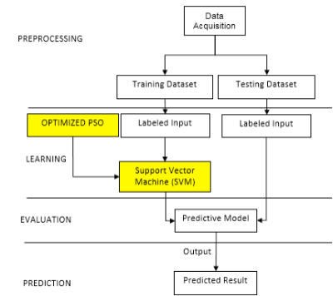
Existing Works
1) An Optimized SVM based on PSO for Cryptocurrency Forecasting
CMRCET-CSE
‹#›

Slide 9
Existing Works
2) Time-Series Prediction of Cryptocurrency Market using Machine Learning Techniques
To predict the market price and stability of Bitcoin in Crypto-market, a machine learning based time series analysis has been applied. Time-series analysis can predict the future ups and downs in the price of Bitcoin by using three algorithms ARIMA, XGBoost, FBProphet.
This project use ARIMA, FBProphet, XG Boosting for time series analysis as a machine learning techniques. The parameters on the basis of which we have evaluated these models are Root Mean Square Error (RMSE), Mean Absolute Error (MAE) and R2 conducted experiments on these three techniques, after conducting time series analysis, ARIMA considered as the best model.
CMRCET-CSE
‹#›

Slide 10
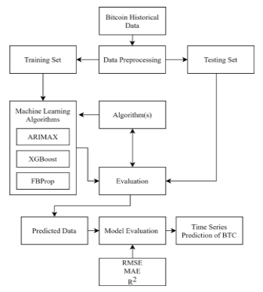
Existing Works
2) Time-Series Prediction of Cryptocurrency Market using Machine Learning Techniques
CMRCET-CSE
‹#›

Slide 11
Existing Works
3) An Accurate Bitcoin Price Prediction using logistic regression Machine Learning model
The proposed model is more focused on leveraging the accurate forecast of bitcoin prices via the normalization of a particular dataset. It is a classification problem which is used to predict a binary outcome given a set of independent variables. It is a regression model to predict the probability that a given data entry belongs to the category numbered as “1”.
The logistic regression model computes a weighted sum of the input variables similar to the linear regression, but it runs the result through a special non-linear function, the logistic function or sigmoid function to produce the output y this dataset has been trained to deploy a more accurate forecast of the bitcoin price.
CMRCET-CSE
‹#›

Slide 12
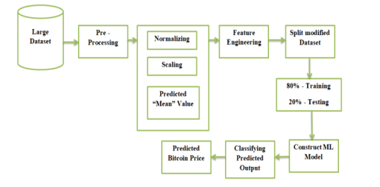
Existing Works
3) An Accurate Bitcoin Price Prediction using logistic regression Machine Learning model
CMRCET-CSE
‹#›

Slide 13
Results of Existing System
Accuracy of SVM based Approach is 75 %
Accuracy of Time series prediction is ARIMA considered as the best model for forecasting Bitcoin price in the crypto-market with RMSE score of 322.4 and MAE score of 227.3.
Accuracy of Bitcoin price prediction using Logistic regression machine learning algorithm is 70-80 %
CMRCET-CSE
‹#›

Slide 14
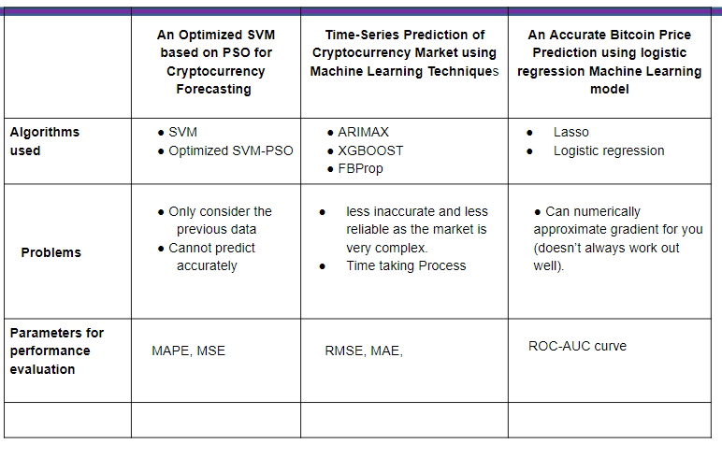
Results of Existing System
CMRCET-CSE
‹#›

Slide 15
Research Objective of Presentation
Existing System uses Linear Regression or several other algorithms which are less accurate in forecasting the accurate values of cryptocurrencies.These systems tries to linearize the whole data which is simply not an efficient method to forecast a complex system like cryptocurrency.
CMRCET-CSE

Slide 16
Problem Defination
The cost of Bitcoin doesn't rely upon the business occasions or mediating government not at all like securities exchange.
Hence, to anticipate the worth we feel it is important to use ML and DL innovation to foresee the cost of Bitcoin.
CMRCET-CSE
‹#›

Slide 17
RESEARCH OBJECTIVE

Slide 18
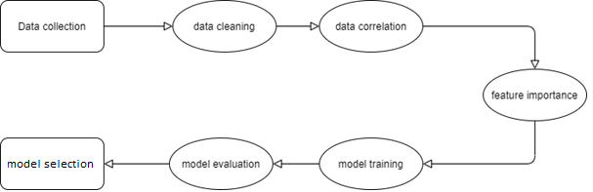
Proposed System architecture
CMRCET-CSE

Slide 19
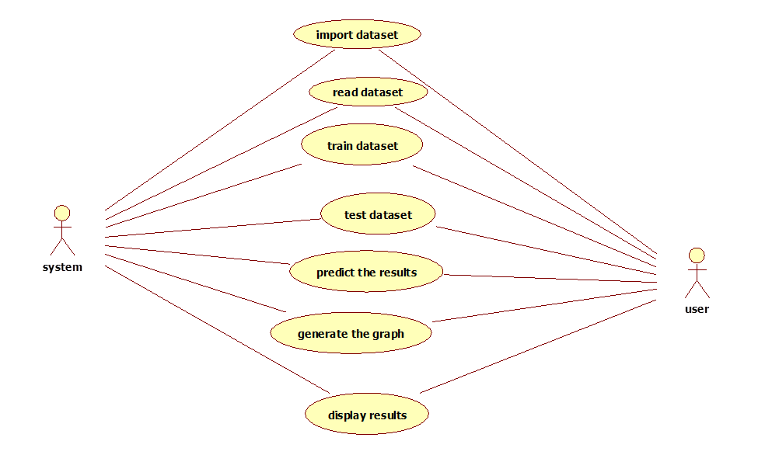
Use case Diagram
CMRCET-CSE
‹#›

Slide 20
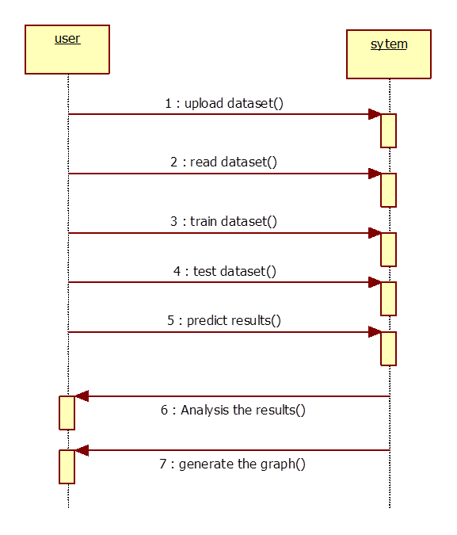
Sequence Diagram
CMRCET-CSE
‹#›

Slide 21
Methods
Recurrent Neural Networks (RNNs):RNNs are a type of neural network that are designed to handle sequential data. They work by passing information from one step of the sequence to the next using a hidden state. The hidden state is updated at each step based on the current input and the previous hidden state. In the context of Bitcoin price prediction, an RNN would take in a sequence of historical Bitcoin prices as inputs and predict the next price in the sequence
Long Short-Term Memory (LSTM): handle the vanishing gradient problem. It works by adding a "memory cell" to the hidden state, which allows the network to remember information for longer periods of time. The memory cell has three gates: an input gate, an output gate, and a forget gate. These gates control the flow of information into and out of the memory cell, allowing the network to selectively remember or forget information as needed.
CMRCET-CSE

Slide 22
Comparison of proposed system with an existed system
CMRCET-CSE

Slide 23
Performance Measure
Mean Squared Error (MSE): This measures the average of the squared differences between the predicted and actual Bitcoin prices. A lower MSE indicates better performance.
Mean Absolute Error (MAE): This measures the average of the absolute differences between the predicted and actual Bitcoin prices. A lower MAE indicates better performance.
CMRCET-CSE

Slide 24
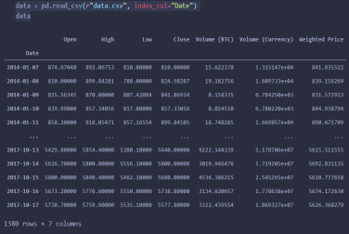
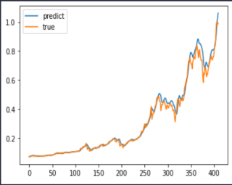
Results
Dataset
Predicted vs. True Price
CMRCET-CSE
‹#›

Slide 25
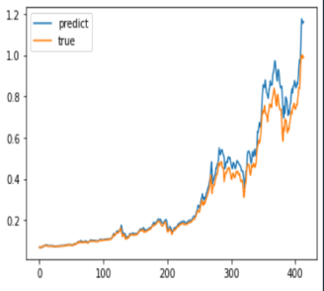
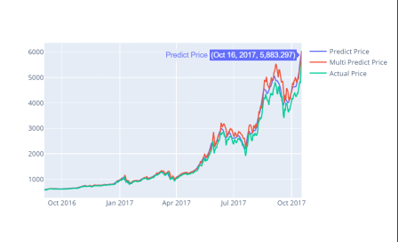
Results
Multi Predict vs. True Price
Final Result

Slide 26

Conclusion
We have designed a system to provide an accurate prediction of bitcoin prices. The efficiency of the algorithm has been further increased with use of Neural networks specifically by using the Long Short Term Memory algorithm. The system will satisfy customers by providing accurate output and preventing the risk of investing in the wrong house. Additional features for the customer’s benefit can also be added to the system without disturbing its core functionality.
CMRCET-CSE
‹#›

Slide 27

Future work
With the rising attention and developments surrounding cryptocurrencies, there are a plethora of cryptocurrencies available in the market and also many new ones being introduced into the market daily. In order to make use of this situation, this system can also be implemented to predict the prices of other major cryptocurrencies like Ethereum, Litecoin, Cardano etc. which would enable investors or traders to diversify their portfolio and also get better returns.
CMRCET-CSE
‹#›

Slide 28
References
Rob J Hyndman, “Forecasting: Principles and Practice,” no. September, 2014.
Agrawal J, Chourasia V, Mittra A. 2013. State-of-the-art in stock prediction techniques. International Journal of Advanced Research in Electrical, Electronics and Instrumentation Engineering 2(4):1360–1366.
Kazem A, Sharifi E, Hussain FK, Morteza S, Hussain OK. 2013. Support vector regression with chaos-based firefly algorithm for stock market price forecasting. Applied soft computing 13(2):947–958.
R. A. Juanda, Jondri, and A. A. Rohmawati, “Bitcoin Price Prediction by Using Recurrent Neural Network,” eProceeding Eng., vol. 5, no. 2, pp. 3682–3690, 2018.
R. Albariqi, “Bitcoin Price Change Prediction Using Artificial Neural Network,” 2018.
CMRCET-CSE
‹#›

